Slide 1
Special functions and Integral Transforms MAT 241
Dr. Mohamed Adel
mohamed.adel@aiet.edu.eg

Slide 2
Lecture (10): Bessel Functions

Slide 3

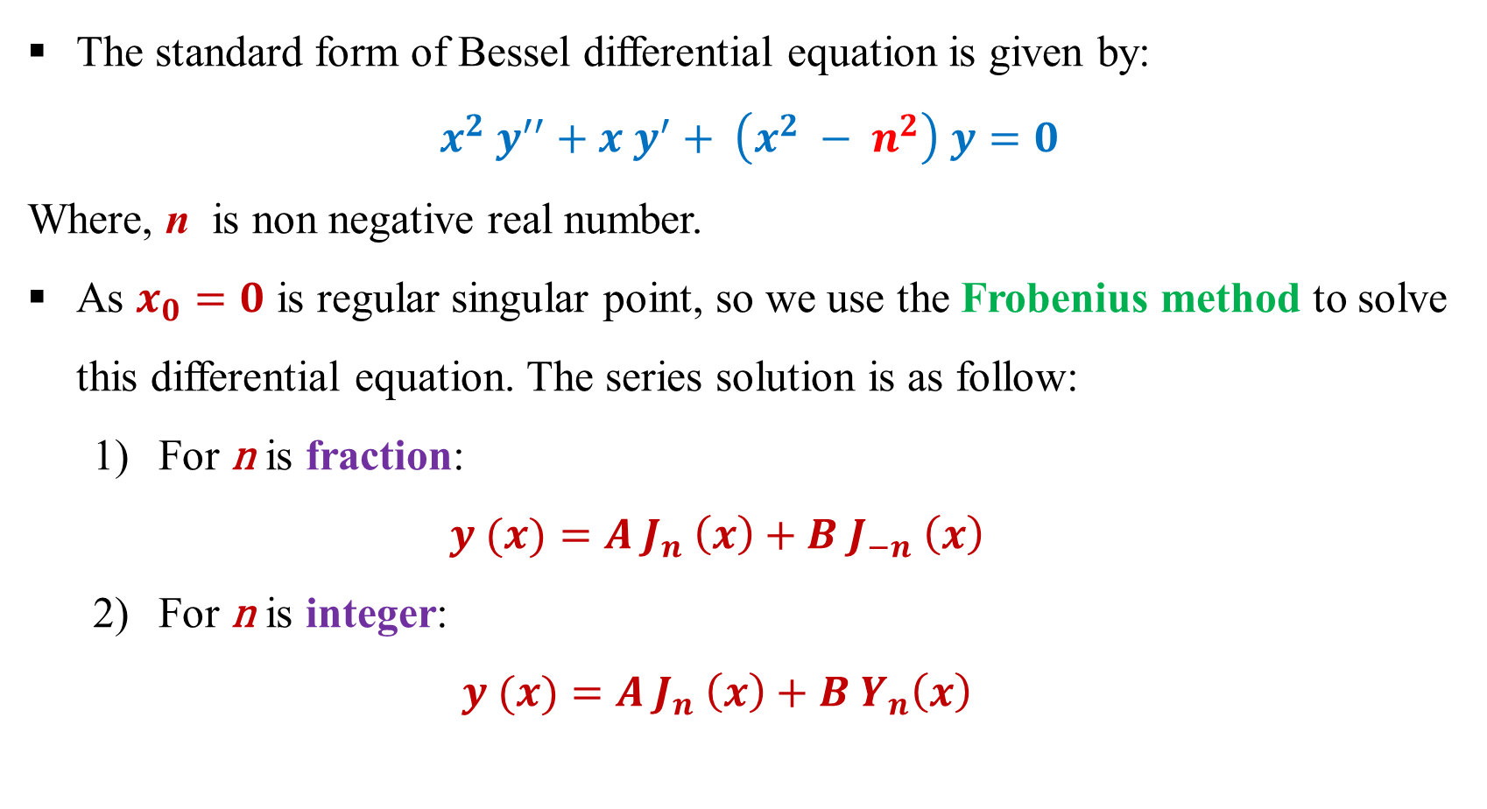
Bessel Function:
The standard form of Bessel differential equation is given by:
$$x^{2} y^{′′}+x y^{′}+ \left(x^{2} − n^{2}\right) y=0$$
Where, n is non negative real number.
As $x_{0}=0$ is regular singular point, so we use the Frobenius method to solve this differential equation. The series solution is as follow:
For n is fraction:
$$y (x)=A J_{n} \left(x\right)+B J_{−n} \left(x\right)$$
For n is integer:
$$y (x)=A J_{n} \left(x\right)+B Y_{n}\left(x\right)$$
Second Kind

Slide 4
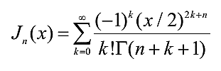
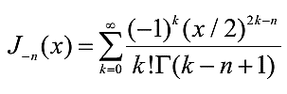
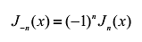
Bessel Function Definition:
Frist Kind:
If n is integer, then:

Slide 5
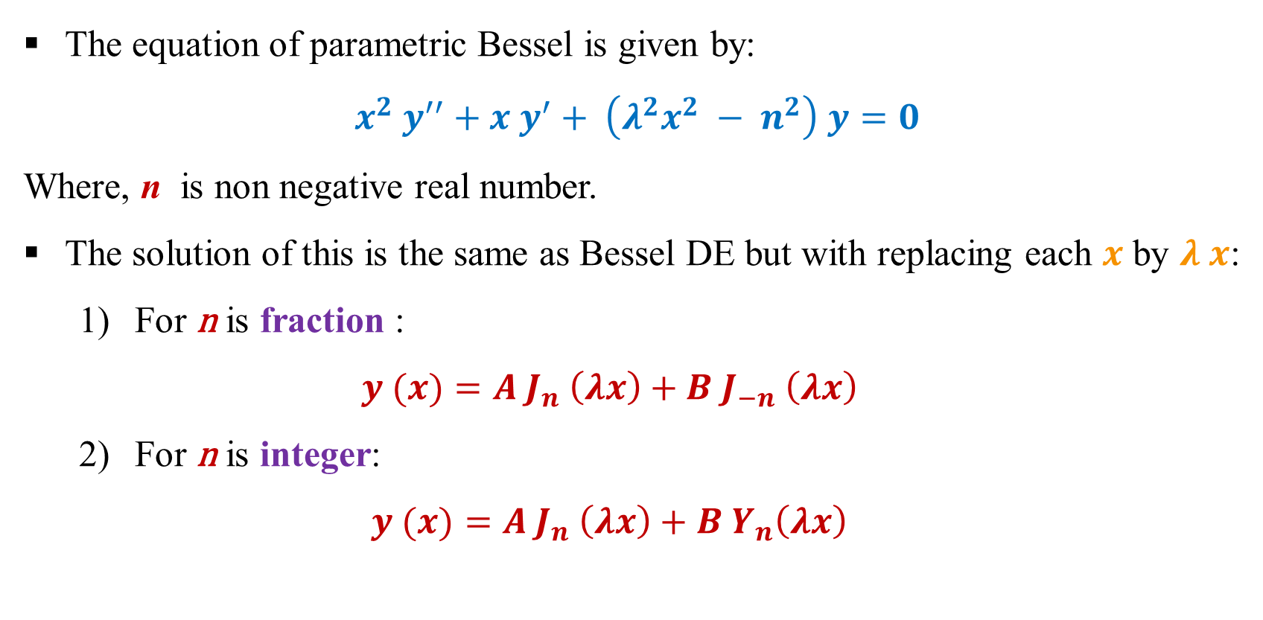
Parametric Bessel
The equation of parametric Bessel is given by:
$$x^{2} y^{′′}+x y^{′}+ \left(λ^{2}x^{2} − n^{2}\right) y=0$$
Where, n is non negative real number.
The solution of this is the same as Bessel DE but with replacing each $x$ by $λ x$:
For n is fraction :
$$y (x)=A J_{n} \left(λx\right)+B J_{−n} \left(λx\right)$$
For n is integer:
$$y (x)=A J_{n} \left(λx\right)+B Y_{n}\left(λx\right)$$

Slide 6
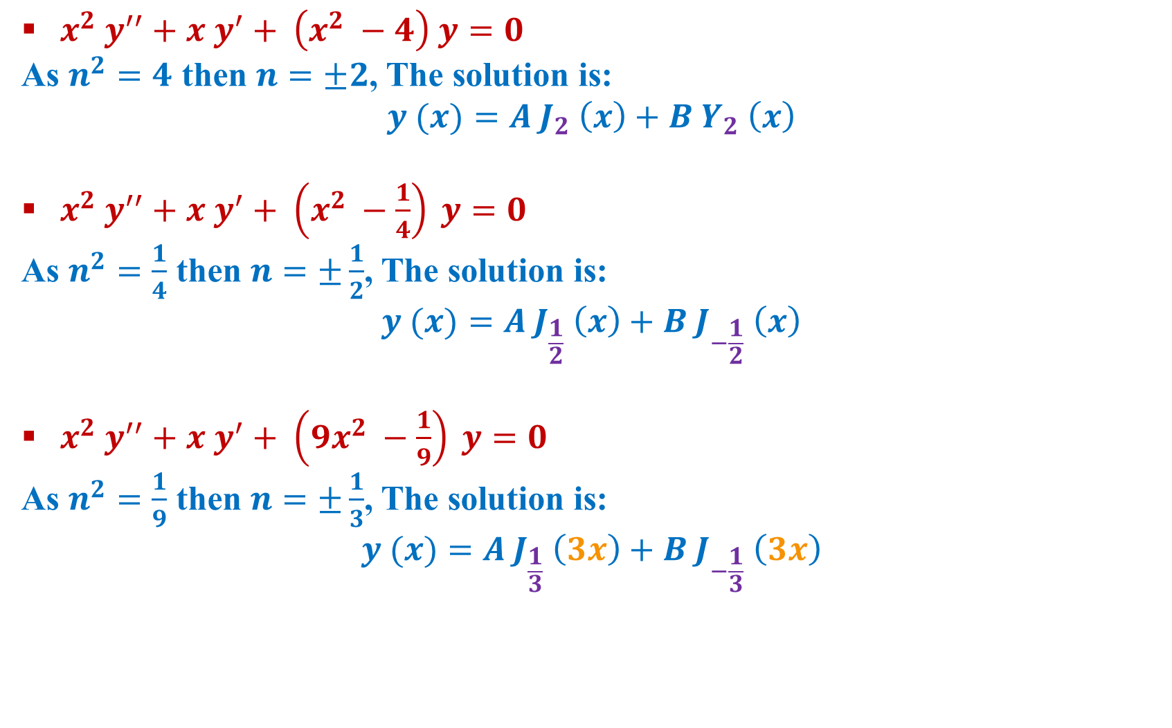
Example:
$x^{2} y^{′′}+x y^{′}+ \left(x^{2} −4\right) y=0$
As $n^{2}=4$ then $n=±2$, The solution is:
$$y (x)=A J_{2} \left(x\right)+B Y_{2} \left(x\right)$$
$x^{2} y^{′′}+x y^{′}+ \left(x^{2} −\frac{1}{4}\right) y=0$
As $n^{2}=\frac{1}{4}$ then $n=±\frac{1}{2}$, The solution is:
$$y (x)=A J_{\frac{1}{2}} \left(x\right)+B J_{−\frac{1}{2}} \left(x\right)$$
$x^{2} y^{′′}+x y^{′}+ \left(9x^{2} −\frac{1}{9}\right) y=0$
As $n^{2}=\frac{1}{9}$ then $n=±\frac{1}{3}$, The solution is:
$$y (x)=A J_{\frac{1}{3}} \left(3x\right)+B J_{−\frac{1}{3}} \left(3x\right)$$

Slide 7
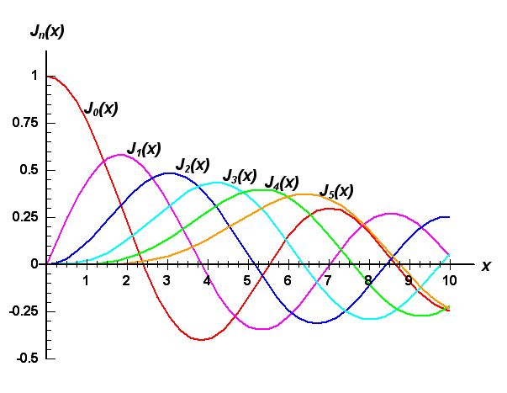
Bessel Function First Kind

Slide 8
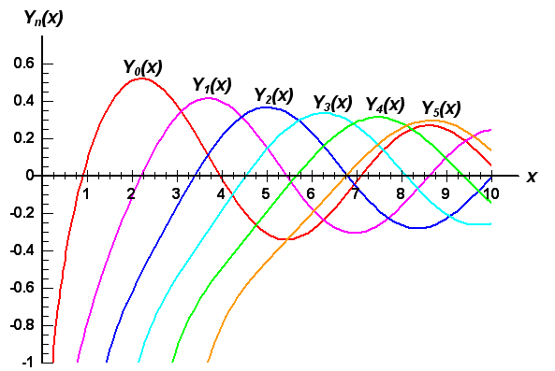
Bessel Function Second Kind

Slide 9
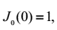
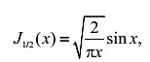
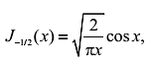
Bessel Function Properties:

Slide 10
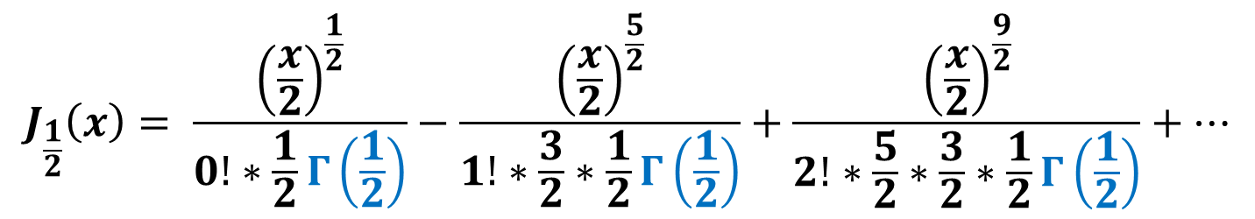
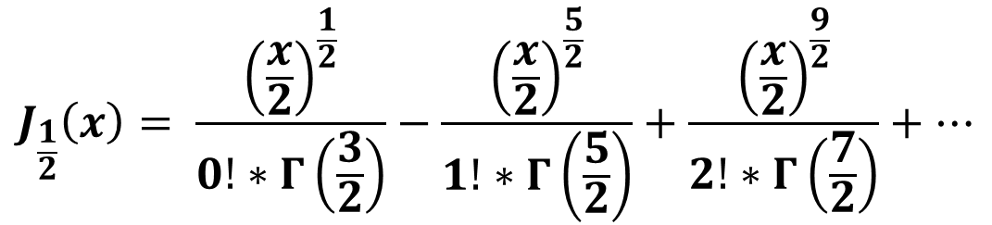

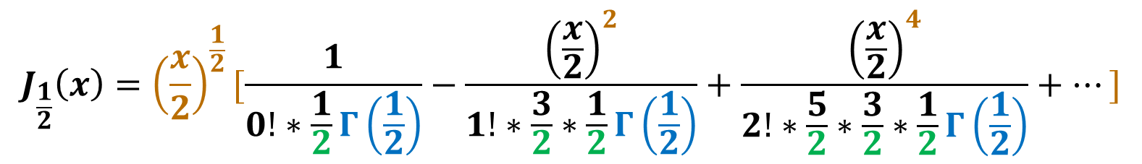
Prove of $J_{\frac{1}{2}}\left(x\right)=\sqrt{\frac{2}{xπ}} sin (x)$
$$J_{\frac{1}{2}}\left(x\right)= \frac{{\left(\frac{x}{2}\right)}^{\frac{1}{2}}}{0!∗Γ\left(\frac{3}{2}\right)}−\frac{{\left(\frac{x}{2}\right)}^{\frac{5}{2}}}{1!∗Γ\left(\frac{5}{2}\right)}+\frac{{\left(\frac{x}{2}\right)}^{\frac{9}{2}}}{2!∗Γ\left(\frac{7}{2}\right)}+…$$
$$J_{\frac{1}{2}}\left(x\right)= \frac{{\left(\frac{x}{2}\right)}^{\frac{1}{2}}}{0!∗\frac{1}{2}Γ\left(\frac{1}{2}\right)}−\frac{{\left(\frac{x}{2}\right)}^{\frac{5}{2}}}{1!∗\frac{3}{2}∗\frac{1}{2}Γ\left(\frac{1}{2}\right)}+\frac{{\left(\frac{x}{2}\right)}^{\frac{9}{2}}}{2!∗\frac{5}{2}∗\frac{3}{2}∗\frac{1}{2}Γ\left(\frac{1}{2}\right)}+…$$
$$J_{\frac{1}{2}}\left(x\right)={\left(\frac{x}{2}\right)}^{\frac{1}{2}}[\frac{1}{0!∗\frac{1}{2}Γ\left(\frac{1}{2}\right)}−\frac{{\left(\frac{x}{2}\right)}^{2}}{1!∗\frac{3}{2}∗\frac{1}{2}Γ\left(\frac{1}{2}\right)}+\frac{{\left(\frac{x}{2}\right)}^{4}}{2!∗\frac{5}{2}∗\frac{3}{2}∗\frac{1}{2}Γ\left(\frac{1}{2}\right)}+…]$$

Slide 11
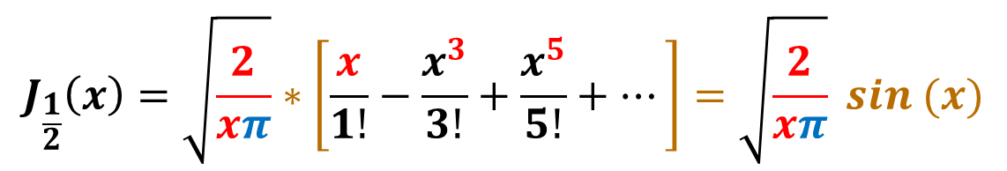
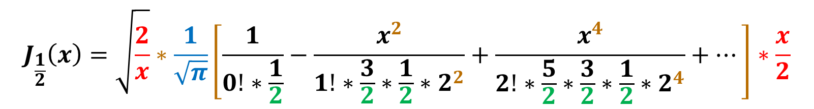
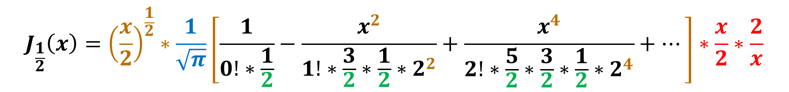
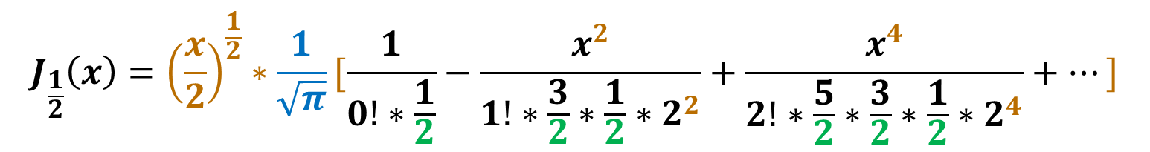
$$J_{\frac{1}{2}}\left(x\right)={\left(\frac{x}{2}\right)}^{\frac{1}{2}}∗\frac{1}{\sqrt{π}}[\frac{1}{0!∗\frac{1}{2}}−\frac{x^{2}}{1!∗\frac{3}{2}∗\frac{1}{2}∗2^{2}}+\frac{x^{4}}{2!∗\frac{5}{2}∗\frac{3}{2}∗\frac{1}{2}∗2^{4}}+…]$$
$$J_{\frac{1}{2}}\left(x\right)={\left(\frac{x}{2}\right)}^{\frac{1}{2}}∗\frac{1}{\sqrt{π}}\left[\frac{1}{0!∗\frac{1}{2}}−\frac{x^{2}}{1!∗\frac{3}{2}∗\frac{1}{2}∗2^{2}}+\frac{x^{4}}{2!∗\frac{5}{2}∗\frac{3}{2}∗\frac{1}{2}∗2^{4}}+…\right]∗\frac{x}{2}∗\frac{2}{x}$$
$$J_{\frac{1}{2}}\left(x\right)=\sqrt{\frac{2}{x}}∗\frac{1}{\sqrt{π}}\left[\frac{1}{0!∗\frac{1}{2}}−\frac{x^{2}}{1!∗\frac{3}{2}∗\frac{1}{2}∗2^{2}}+\frac{x^{4}}{2!∗\frac{5}{2}∗\frac{3}{2}∗\frac{1}{2}∗2^{4}}+…\right]∗\frac{x}{2}$$
$$J_{\frac{1}{2}}\left(x\right)=\sqrt{\frac{2}{xπ}}∗\left[\frac{x}{1!}−\frac{x^{3}}{3!}+\frac{x^{5}}{5!}+…\right]=\sqrt{\frac{2}{xπ}} sin (x)$$

Slide 12
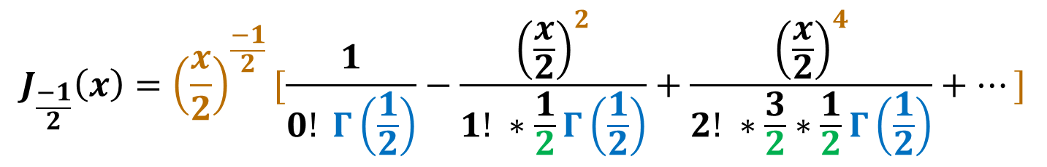
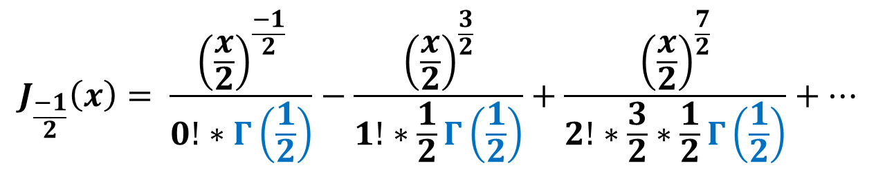
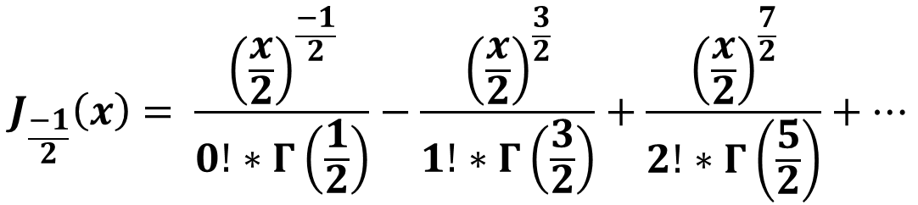

Prove of $J_{−\frac{1}{2}}\left(x\right)=\sqrt{\frac{2}{xπ}} cos (x)$
$$J_{\frac{−1}{2}}\left(x\right)= \frac{{\left(\frac{x}{2}\right)}^{\frac{−1}{2}}}{0!∗Γ\left(\frac{1}{2}\right)}−\frac{{\left(\frac{x}{2}\right)}^{\frac{3}{2}}}{1!∗Γ\left(\frac{3}{2}\right)}+\frac{{\left(\frac{x}{2}\right)}^{\frac{7}{2}}}{2!∗Γ\left(\frac{5}{2}\right)}+…$$
$$J_{\frac{−1}{2}}\left(x\right)= \frac{{\left(\frac{x}{2}\right)}^{\frac{−1}{2}}}{0!∗Γ\left(\frac{1}{2}\right)}−\frac{{\left(\frac{x}{2}\right)}^{\frac{3}{2}}}{1!∗\frac{1}{2}Γ\left(\frac{1}{2}\right)}+\frac{{\left(\frac{x}{2}\right)}^{\frac{7}{2}}}{2!∗\frac{3}{2}∗\frac{1}{2}Γ\left(\frac{1}{2}\right)}+…$$
$$J_{\frac{−1}{2}}\left(x\right)={\left(\frac{x}{2}\right)}^{\frac{−1}{2}}[\frac{1}{0! Γ\left(\frac{1}{2}\right)}−\frac{{\left(\frac{x}{2}\right)}^{2}}{1! ∗\frac{1}{2}Γ\left(\frac{1}{2}\right)}+\frac{{\left(\frac{x}{2}\right)}^{4}}{2! ∗\frac{3}{2}∗\frac{1}{2}Γ\left(\frac{1}{2}\right)}+…]$$

Slide 13
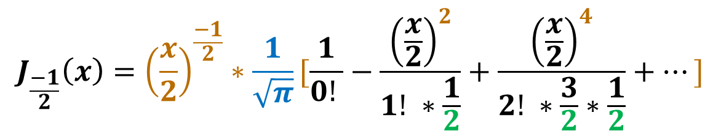

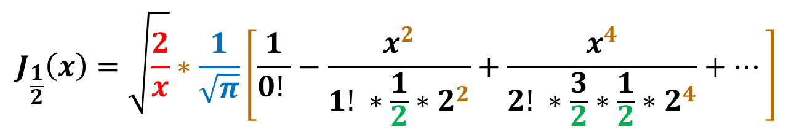
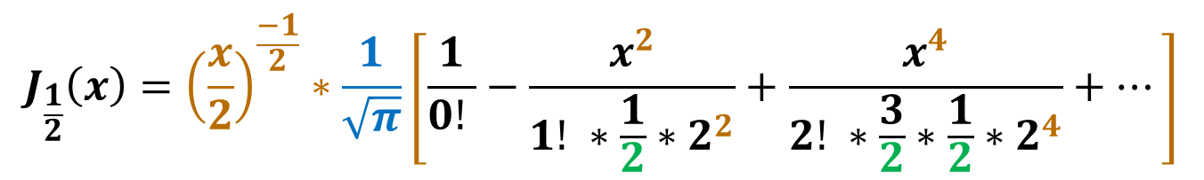
$$J_{\frac{−1}{2}}\left(x\right)={\left(\frac{x}{2}\right)}^{\frac{−1}{2}}∗\frac{1}{\sqrt{π}}[\frac{1}{0! }−\frac{{\left(\frac{x}{2}\right)}^{2}}{1! ∗\frac{1}{2}}+\frac{{\left(\frac{x}{2}\right)}^{4}}{2! ∗\frac{3}{2}∗\frac{1}{2}}+…]$$
$$J_{\frac{1}{2}}\left(x\right)={\left(\frac{x}{2}\right)}^{\frac{−1}{2}}∗\frac{1}{\sqrt{π}}\left[\frac{1}{0! }−\frac{x^{2}}{1! ∗\frac{1}{2}∗2^{2}}+\frac{x^{4}}{2! ∗\frac{3}{2}∗\frac{1}{2}∗2^{4}}+…\right]$$
$$J_{\frac{1}{2}}\left(x\right)=\sqrt{\frac{2}{x}}∗\frac{1}{\sqrt{π}}\left[\frac{1}{0! }−\frac{x^{2}}{1! ∗\frac{1}{2}∗2^{2}}+\frac{x^{4}}{2! ∗\frac{3}{2}∗\frac{1}{2}∗2^{4}}+…\right]$$
$$J_{\frac{1}{2}}\left(x\right)=\sqrt{\frac{2}{xπ}}∗\left[\frac{1}{1!}−\frac{x^{2}}{2!}+\frac{x^{4}}{4!}+…\right]=\sqrt{\frac{2}{xπ}} cos (x)$$

Slide 14
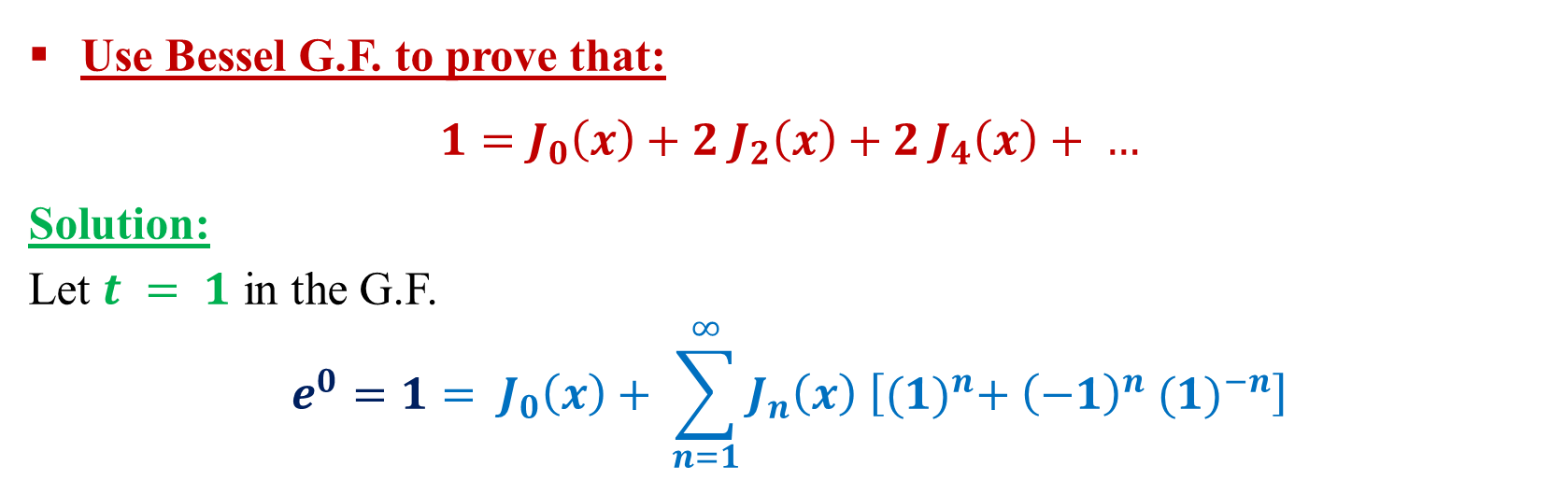
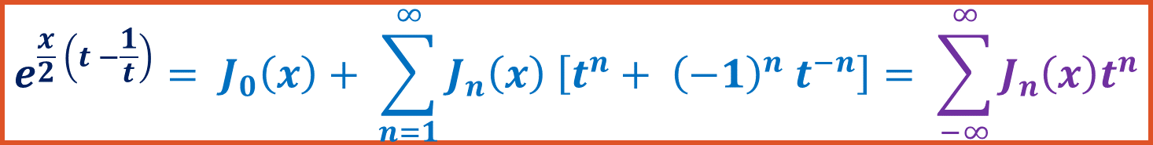
Generating function for Bessel function:
$$e^{\frac{x}{2} \left(t −\frac{1}{t}\right)}= J_{0}\left(x\right)+ \sum_{n=1}^{∞}{J_{n}\left(x\right) \left[t^{n}+ {\left(−1\right)}^{n} t^{−n}\right]}= \sum_{−∞}^{∞}{J_{n}\left(x\right)t^{n}}$$
Use Bessel G.F. to prove that:
$$1=J_{0}\left(x\right)+2 J_{2}\left(x\right)+2 J_{4}\left(x\right)+ …$$
Solution:
Let $t = 1$ in the G.F.
$$e^{0}=1= J_{0}\left(x\right)+ \sum_{n=1}^{∞}{J_{n}\left(x\right) \left[{(1)}^{n}+ {\left(−1\right)}^{n} {(1)}^{−n}\right]}$$

Slide 15
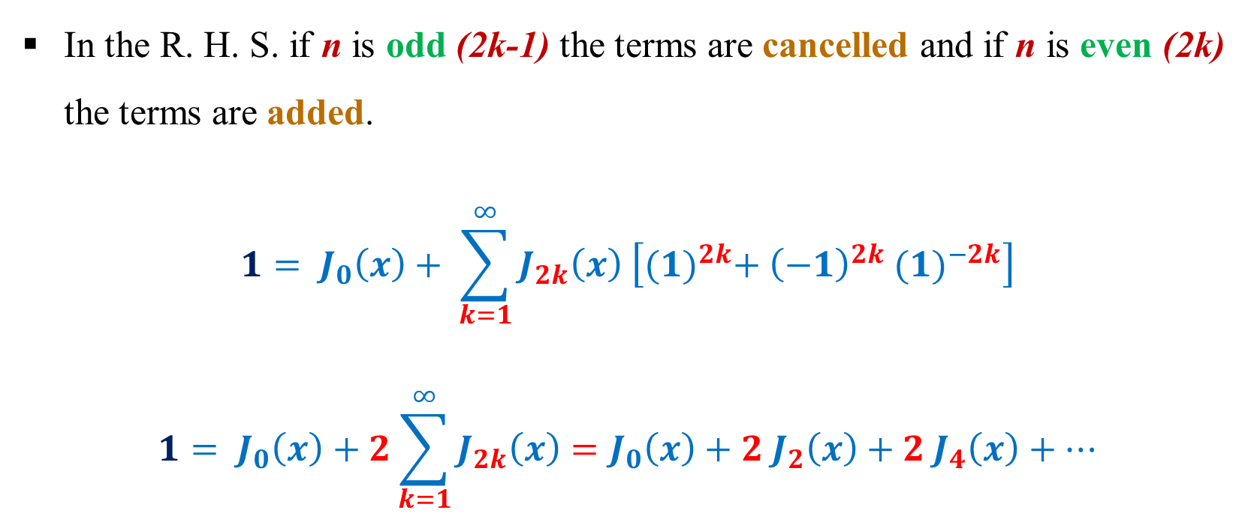
In the R. H. S. if n is odd (2k-1) the terms are cancelled and if n is even (2k) the terms are added.
$$1= J_{0}\left(x\right)+ \sum_{k=1}^{∞}{J_{2k}\left(x\right) \left[{(1)}^{2k}+ {\left(−1\right)}^{2k} {(1)}^{−2k}\right]}$$
$$1= J_{0}\left(x\right)+2\sum_{k=1}^{∞}{J_{2k}\left(x\right)}=J_{0}\left(x\right)+2 J_{2}\left(x\right)+2 J_{4}\left(x\right)+…$$
1
1

Slide 16
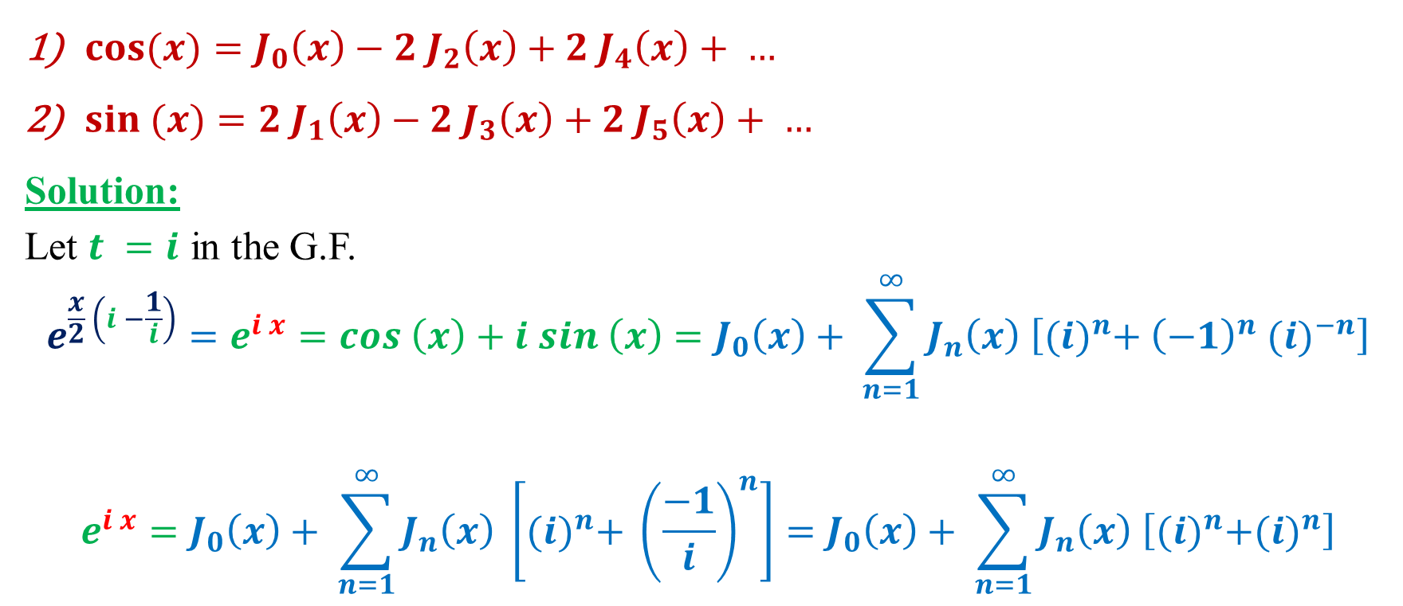
Use Bessel G.F. to prove that:
$\cos{(x)}=J_{0}\left(x\right)−2 J_{2}\left(x\right)+2 J_{4}\left(x\right)+ …$
$\sin{(x)}=2 J_{1}\left(x\right)−2 J_{3}\left(x\right)+2 J_{5}\left(x\right)+ …$
Solution:
Let $t =i$ in the G.F.
$$e^{\frac{x}{2} \left(i −\frac{1}{i}\right)}=e^{i x}=cos \left(x\right)+i sin \left(x\right)=J_{0}\left(x\right)+ \sum_{n=1}^{∞}{J_{n}\left(x\right) \left[{(i)}^{n}+ {\left(−1\right)}^{n} {(i)}^{−n}\right]}$$
$$e^{i x}=J_{0}\left(x\right)+ \sum_{n=1}^{∞}{J_{n}\left(x\right) \left[{(i)}^{n}+ {\left(\frac{−1}{i}\right)}^{n}\right]}=J_{0}\left(x\right)+ \sum_{n=1}^{∞}{J_{n}\left(x\right) \left[{(i)}^{n}+{(i)}^{n}\right]}$$

Slide 17
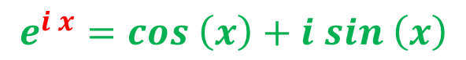

$$e^{i x}=J_{0}\left(x\right)+ \sum_{n=1}^{∞}{J_{n}\left(x\right) \left[{2 (i)}^{n}\right]}$$
$$e^{i x}=J_{0}\left(x\right)+2i J_{1}\left(x\right)−2 J_{2}\left(x\right)−2 i J_{3}\left(x\right)+2 J_{4}\left(x\right)+2i J_{5}\left(x\right)+ …$$
$$e^{i x}=\left(J_{0}\left(x\right)−2 J_{2}\left(x\right)+2 J_{4}\left(x\right)+…\right)+i \left(2 J_{1}\left(x\right)−2 J_{3}\left(x\right)+2 J_{5}\left(x\right)+ …\right)$$
$$e^{i x}=cos \left(x\right)+i sin \left(x\right)$$
$$cos \left(x\right)=\left(J_{0}\left(x\right)−2 J_{2}\left(x\right)+2 J_{4}\left(x\right)+…\right)$$
$$sin \left(x\right)=\left(2 J_{1}\left(x\right)−2 J_{3}\left(x\right)+2 J_{5}\left(x\right)+ …\right)$$

Slide 18
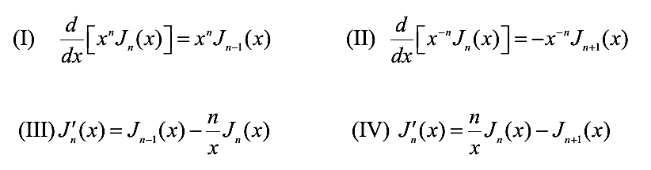
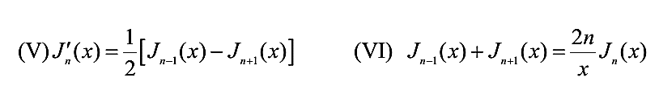
Recurrence Relation for Bessel Function:

Slide 19
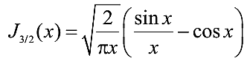
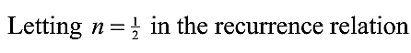
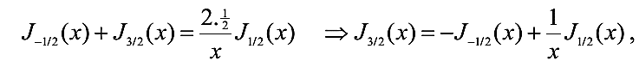
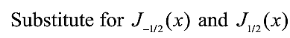
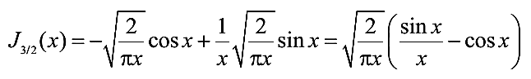
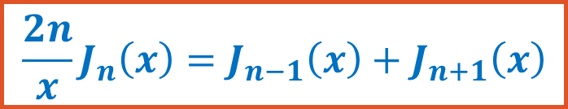
Show that:
$$\frac{2n}{x}J_{n}\left(x\right)=J_{n−1}\left(x\right)+J_{n+1}\left(x\right)$$

Slide 20
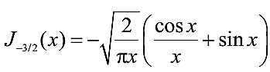
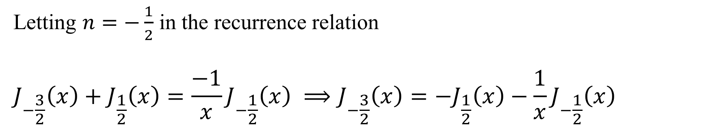
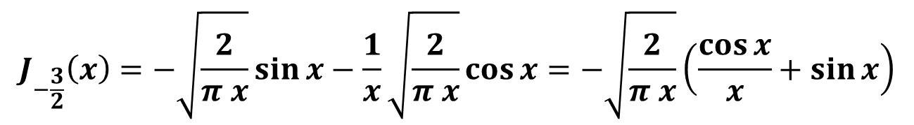
Show that:
$$\frac{2n}{x}J_{n}\left(x\right)=J_{n−1}\left(x\right)+J_{n+1}\left(x\right)$$
Letting $n=−\frac{1}{2}$ in the recurrence relation
$$J_{−\frac{3}{2}}\left(x\right)+J_{\frac{1}{2}}\left(x\right)=\frac{−1}{x}J_{−\frac{1}{2}}\left(x\right) ⟹J_{−\frac{3}{2}}\left(x\right)=−J_{\frac{1}{2}}\left(x\right)−\frac{1}{x}J_{−\frac{1}{2}}\left(x\right)$$
$$J_{−\frac{3}{2}}\left(x\right)=−\sqrt{\frac{2}{π x}}\sin{x}−\frac{1}{x}\sqrt{\frac{2}{π x}}\cos{x}=−\sqrt{\frac{2}{π x}}\left(\frac{\cos{x}}{x}+\sin{x}\right)$$

Slide 21

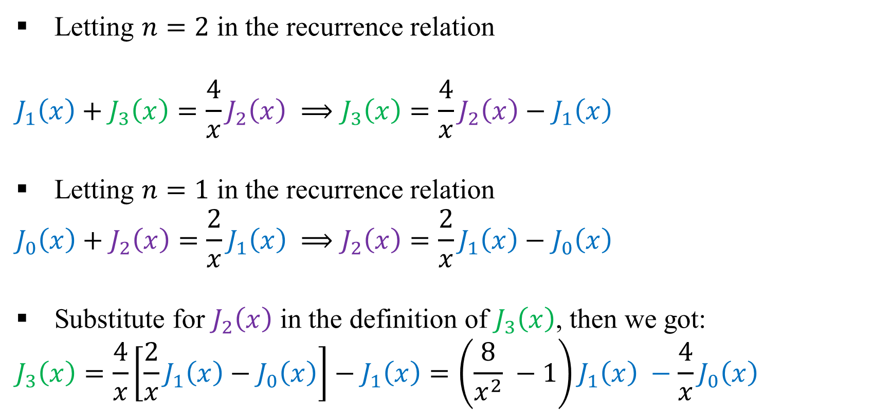
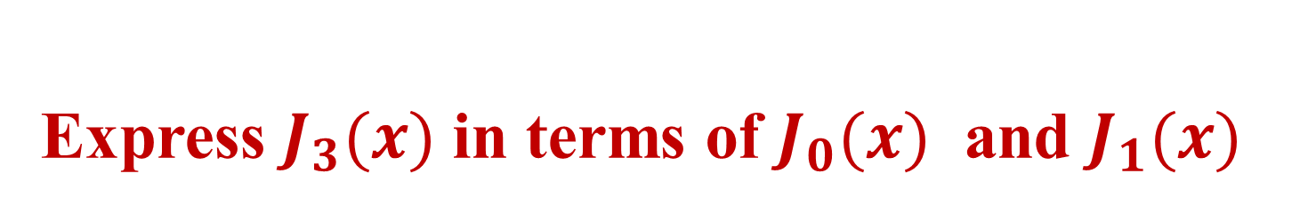
Express $J_{3}(x)$ in terms of $J_{0}(x)$ and $J_{1}(x)$
$$\frac{2n}{x}J_{n}\left(x\right)=J_{n−1}\left(x\right)+J_{n+1}\left(x\right)$$
Letting $n=2$ in the recurrence relation
$$J_{1}\left(x\right)+J_{3}\left(x\right)=\frac{4}{x}J_{2}\left(x\right) ⟹J_{3}\left(x\right)=\frac{4}{x}J_{2}\left(x\right)−J_{1}\left(x\right)$$
Letting $n=1$ in the recurrence relation
$$J_{0}\left(x\right)+J_{2}\left(x\right)=\frac{2}{x}J_{1}\left(x\right) ⟹J_{2}\left(x\right)=\frac{2}{x}J_{1}\left(x\right)−J_{0}\left(x\right)$$
Substitute for $J_{2}\left(x\right)$ in the definition of $J_{3}\left(x\right)$, then we got:
$$J_{3}\left(x\right)=\frac{4}{x}\left[\frac{2}{x}J_{1}\left(x\right)−J_{0}\left(x\right)\right]−J_{1}\left(x\right)=\left(\frac{8}{x^{2}} −1\right)J_{1}\left(x\right) −\frac{4}{x}J_{0}\left(x\right)$$

Slide 22
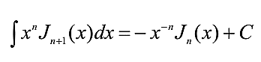
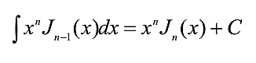
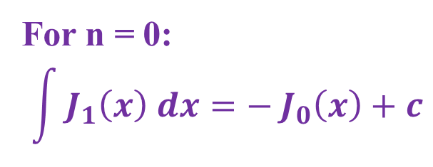
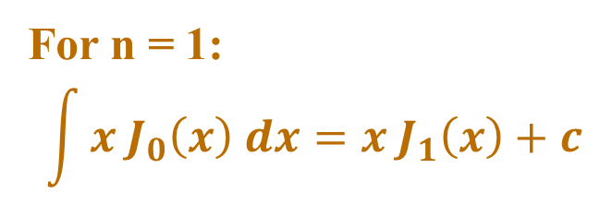
Integral involves Bessel Functions:
For n = 1:
$$\int{{x J}_{0}\left(x\right) dx}=x J_{1}\left(x\right)+c$$
For n = 0:
$$\int{J_{1}\left(x\right) dx}=− J_{0}\left(x\right)+c$$

Slide 23
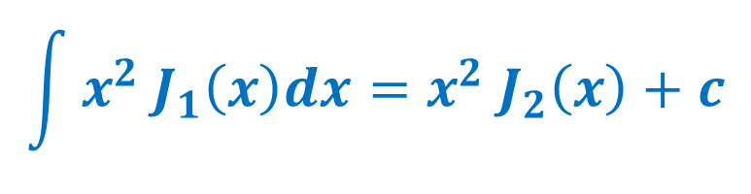

Evaluate: (1) $\int{x^{2} J_{1}\left(x\right)dx}$
$$\int{x^{2} J_{1}\left(x\right)dx}=x^{2} J_{2}\left(x\right)+c$$

Slide 24
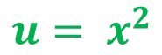
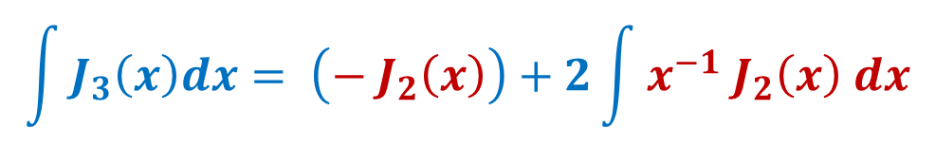
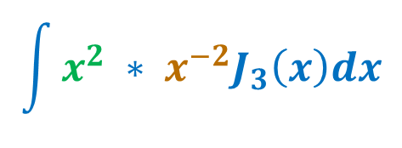






Evaluate: (3) $\int{J_{3}\left(x\right)dx}$
$$\int{x^{2} ∗ x^{−2}J_{3}\left(x\right)dx}$$
$$u= x^{2}$$
$$dv=x^{−2} J_{3}\left(x\right) dx$$
$$du=2 x dx$$
$$v={−x}^{−2} J_{2}\left(x\right)$$
$$\int{x^{2} ∗ x^{−2}J_{3}\left(x\right)dx}= \left(x^{2} ∗{−x}^{−2} J_{2}\left(x\right)\right)−\int{{−x}^{−2} J_{2}\left(x\right) ∗2 x dx}$$
$$\int{J_{3}\left(x\right)dx}= \left(− J_{2}\left(x\right)\right)+2\int{x^{−1} J_{2}\left(x\right) dx}$$
$$\int{J_{3}\left(x\right)dx}= \left(− J_{2}\left(x\right)\right)−2 \left(x^{−1} J_{1}\left(x\right)\right)+c$$

